Slide 1
Problem – Solution Techniques
Finite difference/Volume methods
Spatially and temporally discretizing the 1D heat equation
Spectral methods
Use Fourier transforms to turn PDE into an ODE and solve in spectral domain
Reduced Order Models
Construct a lower dimensional model that approximates the exact solution

Slide 2
Convolutional Autoencoder and LSTM U-Net Architecture for Reduced Order Modeling
Flow Field
(x, y velocity & pressure)
CFlow Field
(x, y velocity & pressure)
Time = t
Time = t+dt
Long Short Term Memory Network
Encoder
Decoder
Compressed data at time = t
Compressed data at time = t+dt
Concatenation across time

Slide 3
Flow Control and Optimization
Control
Parameterization and Optimization
Flow control is broadly the deliberate changing of a fluidic system through actuation and sensor measurement
PID controllers are an excellent example
Goal: Use CAE+LSTM architecture as the basis for a Model Predictive Control or feed forward process controller
Optimization is broadly the parametric study of minimizing or maximizing a desired behavior
The optimization of airfoil shape is an excellent example
Goal: Demonstrate CAE+LSTM architecture performance on a parametric study of a fluidic system (e.g. 2D cavity flow, stenosed flows, airfoil, etc)

Slide 4
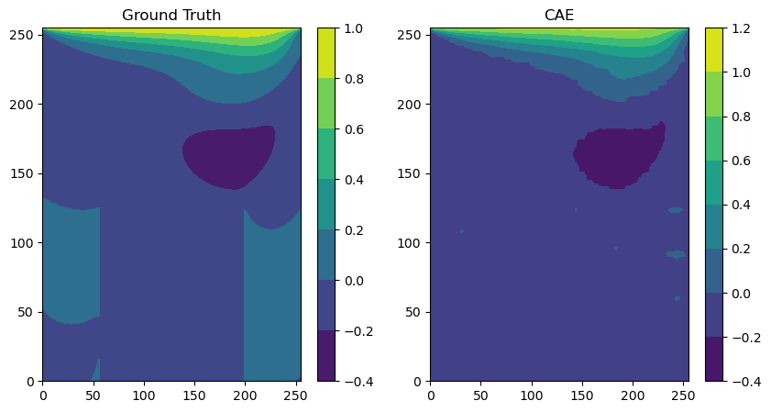
Preliminary Autoencoder Results – X velocity

